Slide 1
Neutrality
Beneficiary
(Recipient State)
Sphere
Donor Sphere
Humanitarian Space
Impartiality
Independence
Figure 1.1

Slide 2
Commercial Contractors
Academic Community
Private and Governmental Donors
Humanitarian Organization
Beneficiaries
Peer Group and Start-Ups
Military
Figure 1.2

Slide 3
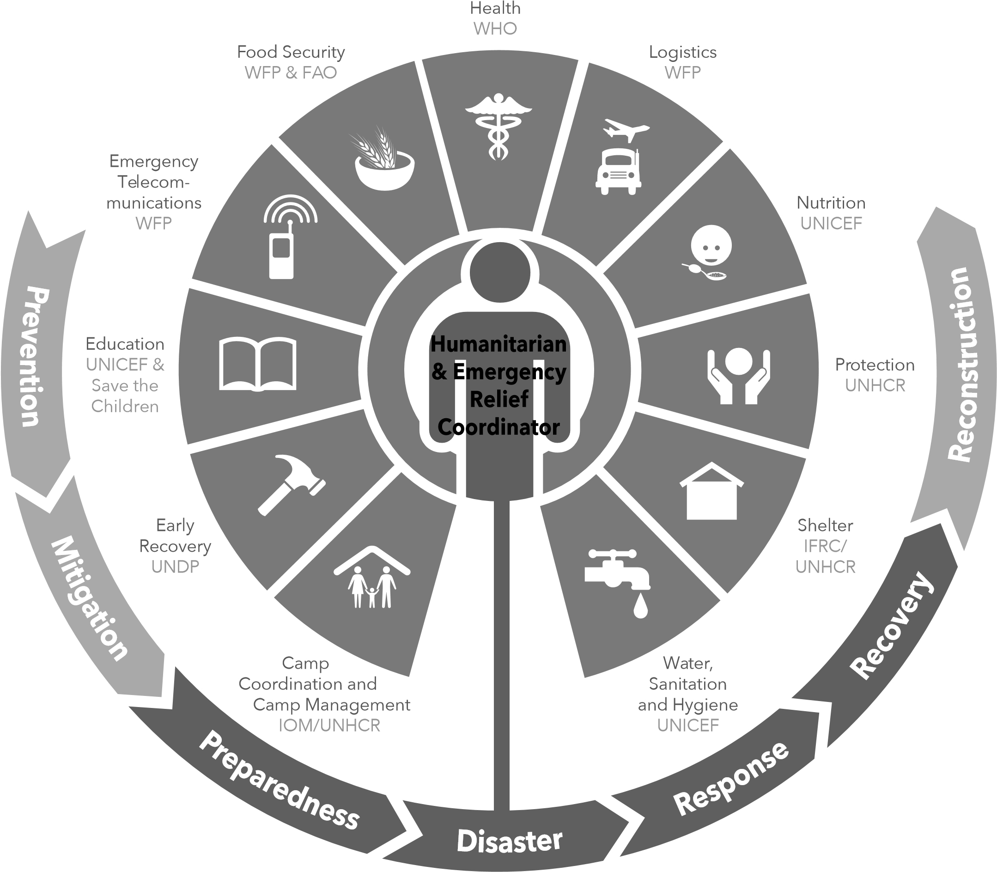
Figure 1.3

Slide 4
Planning and Direction
Processing and Exploitation
Analysis and Production
Dissemination and Integration
Collection
Figure 2.1

Slide 5
Processing and Exploitation
Analysis and Production
Collection
Data
Information
Intelligence
Operational Environment
Figure 2.2

Slide 6
Policy
Program 1
Project 1.1
Project 1.2
Program 2
Project 2.1
Policy Level
Program Level
Project Level
Project 2.2
Project 2.3
Objectives
Assumptions
Activities
Results
Sub-Objectives
Assumptions
Sub-Activities
Sub-Results
Sub-Objectives
Assumptions
Sub-Activities
Sub-Results
Figure 2.3

Slide 7
Indicators
Verification measures for fulfillment of goals
Goal
Higher level objective towards expected contribution
Assumptions
Important events, conditions, or decisions necessary for sustaining objectives in the long run
Indicators
Verification measures for fulfillment of purpose
Purpose
Expected Effect achieved as result of the project
(mention target groups)
Assumptions
Important events, conditions, or decisions outside the control of the project, necessary for the humanitarian objective to be attained
Indicators
Verification measures whether outputs are produced
Outputs
Results that the project management should be able to guarantee
Assumptions
Important events, conditions, or decisions outside the control of the project management, necessary for the achievement of the immediate objective
Activities
Activities necessary in order to produce the outputs
Inputs
Goods and services necessary to undertake the activities
Assumptions
Important events, conditions, or decisions outside the control of the project management, necessary for the production of the outputs
Figure 2.4

Slide 8
Figure 3.1

Slide 9
Figure 3.2

Slide 10
Context
Who?
What?
When?
How?
Why?
(To/ From) Where?
Figure 4.1

Slide 11
Jul
Belg and Pastoral Main Season Assessment
Aug
Mid-Meher Season Assessment
Jan
Food Supply Prospect and Humanitarian Appeal Release
Nov-Dec
FAO/WPF Crop and Food Supply Assessment (CFSAM)
Feb-May
Belg Rains
Jun-Sep
Typical hunger period
Feb Mar Apr May Jun Jul Aug Sep Oct Nov Dec
Jan 07
Belg harvest
Meher harvest
Pastoral area dry period
Dec-Mar
Majro pastoral rains (Gu/Genna/Sugum)
Mar-May
Major Meher season rains for all crop producing areas
(Karma/Karan pastoral rains for Afar and northern tip of Somali Region)
Mar-May
Government led Multi-Agency Food Security Assessment
Nov-Dec
Figure 4.2

Slide 12
Continuing Arrival of Malian Refugees
Start of Ramadan
Tabaski
Subsidized Cereal Sales
Legislative and Municipal Elections
Transhumant Migration
Transhumant Migration
Land Preparation
Off Season Land Preparation
Off-Season Harvest
Grain Harvest
Lean / Rainy Season
Dry Season
Apr 12 May Jun Jul Aug Sep Oct Nov Dec Jan 13 Feb Mar Apr
Distribution of Agricultural Inputs
Cotton Harvest
Cotton Marketing and Payment
Figure 4.3

Slide 13
Figure 4.4

Slide 14
Step 1. Prepare an Organization Profile: (a) Sectors of Activity; (b) Regional Focus; (c) Competitive Situation; (d) Embeddedness in Humanitarian System;
 | Step 4. Prepare a SW Audit in: (a) Management and Organization; (b) Operations; (c) Finance; (d) Outreach and Accountability; (e) Monitoring and Evaluation
Internal Factors External Factors | Step 5. Develop Alternatives Step 6. Make Strategic Choices; Consider Strategies, Tactics, Action Steps 1 to 6. Test for Consistency. Also Prepare Contingency Plans. (Step 7) | List Internal Strengths (S): (1) (2) (3) | List Internal Weaknesses (W): (1) (2) (3)
Step 2. Identify and Evaluate the Following Factors: (a) Economic (b) Social (c) Political (d) Environmental (e) Health (f) Safety and Security (g) Access and Acceptance (h) Humanitarian Coordination Step 3. Prepare a Forecast, Make Predictions and Assessment of the Near Future | List External Opportunities (O): (Consider Risks Also) (1) (2) (3) | SO: Maxi-Maxi Strategy | WO: Mini-Maxi Strategy
 | List External Threats (T): (1) (2) (3) | ST: Maxi-Mini Strategy | WT: Mini-Mini Strategy
Figure 4.5

Slide 15
Figure 4.6

Slide 16
Figure 4.7

Slide 17
Figure 4.8

Slide 18
Figure 4.9

Slide 19
Effect 1.1
Effect 1.2
Effect 2.1
Effect 2.2
Effect 3.1
Effect 1
Effect 2
Effect 3
Focal Problem
Cause 1
Cause 2
Cause 3
Cause 1.1
Cause 1.2
Cause 2.1
Cause 2.2
Figure 4.10

Slide 20
Tourism distorted
Increased demand on health services
Reduced Productivity
Increased morbidity and mortality
Outbreak of cholera in Kingstown, St Vincent
Poor sanitary conditions
Contaminated water supply
Unhygienic health practices and food preparation
Open pit latrines
Leaking sewers
Flooding in urban areas
Poor maintenance of water mains
Lack of knowledge
Low levels of income
Figure 4.11

Slide 21
Tourism restored
Reduced demand on health services
Productivity restored
Decreased morbidity and mortality
A
B
Outbreak of cholera in Kingstown, St Vincent
A
A
B
Sanitary conditions improved
Potable water supplied in target areas
Hygenic health practices adopted
A
B
A
A
A
B
B
B
Pit latrines improved
Sewer maintenance improve
Flood control measures implemented
Maintenance of water mains improved
Hygene training in target communities
Income generating activities
Alternative A: Infrastructure
Alternative A is focused on infrastructure and could be financed by a donor that has a comparative advantage in supporting this type of activity.
Alternative B: Health Education
Alternative B is focused on health education and behaviour change and could be supported by donors or NGOs specialising in that kind of activity. Together, the two alternatives offer greater potential for realizing the higher level project objectives.
Figure 4.12

Slide 22
Figure 5.1

Slide 23
Figure 5.2

Slide 24
High
Keep Satisfied
Engage Closely and
Influence Activity
Power
Monitor only
(minimum effort)
Keep Informed
Low
Low
Interest
High
Figure 6.1

Slide 25
High
Stakeholder Type 1
Supportive
Strategy:
Involve
Stakeholder Type 4
Mixed Blessing
Strategy:
Collaborate
Potential for Cooperation
Stakeholder Type 2
Marginal
Strategy:
Monitor
Stakeholder Type 3
Non-supportive
Strategy:
Defend
Low
Low
Potential Threat
High
Figure 6.2

Slide 26
Opponent (O)
Moderate Opponent (MO)
Neutral (N)
Moderate Supporter (MS)
Supporter (S)
Figure 6.3

Slide 27
Figure 6.4

Slide 28
B
A
C
D
F
E
Figure 7.1

Slide 29
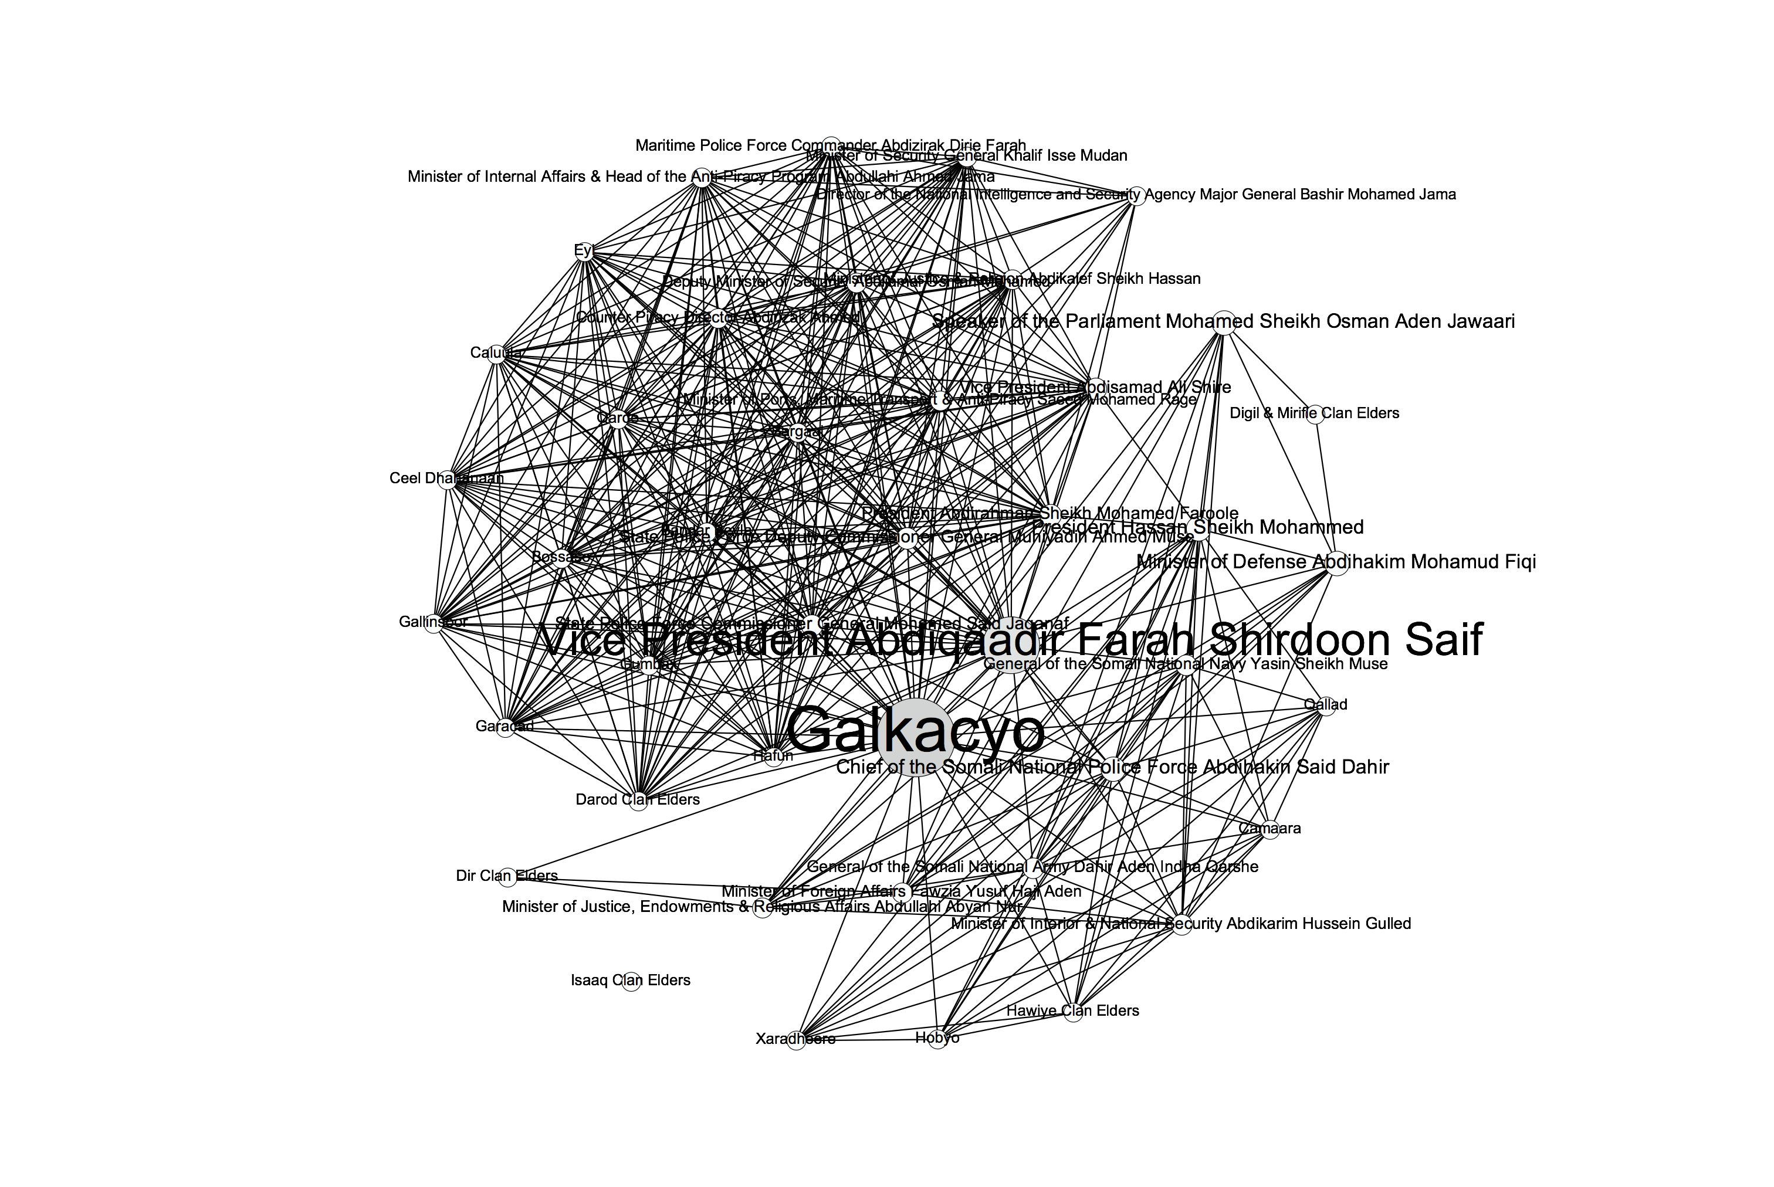
Figure 7.2

Slide 30
C
C
C
A
B
A
B
A
B
Figure 7.3
Figure 7.4
Figure 7.5
C
C
A
B
A
B
Figure 7.6
Figure 7.7

Slide 31
Star-network
Line-network
Circle-network
B
C
B
D
E
A
C
A
B
C
D
E
A
E
D
Figure 7.8

Slide 32
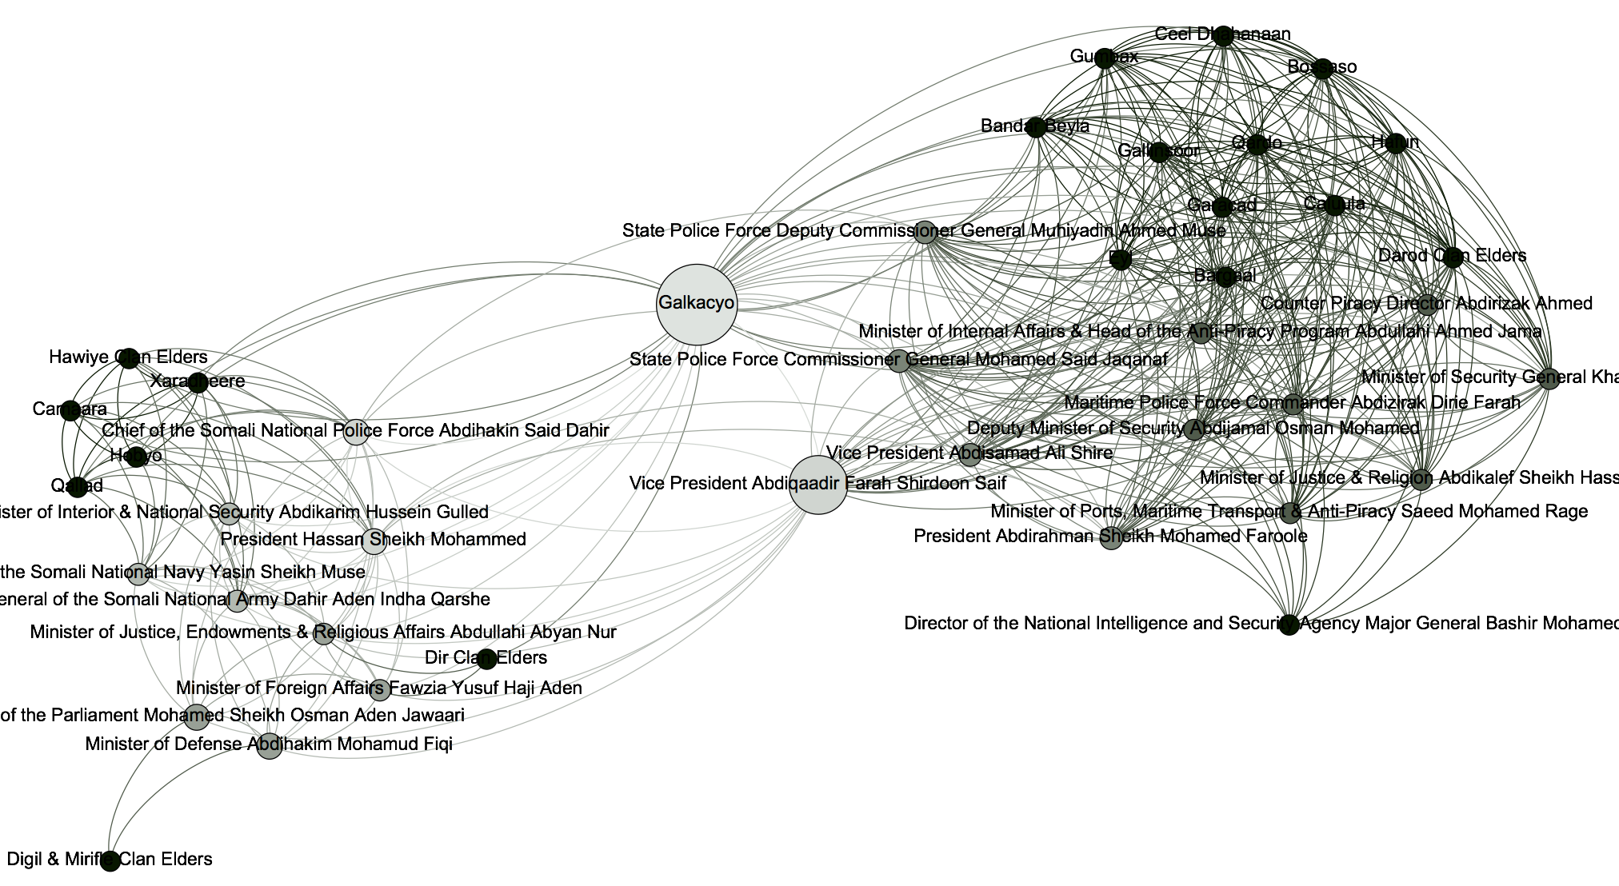
Figure 7.9

Slide 33
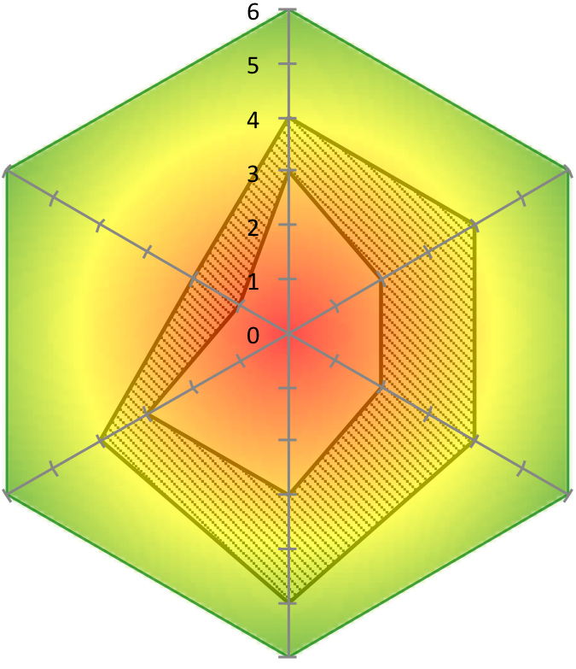
Ex Post (present) Trend
Z ?
Macro-
Level
Micro- AGIRI Trend
Level Hazards Factors
(a, b, c) (x, y, z)
Figure 8.1

Slide 34
Level of security of Context Dimension
0 3 6
β
δ
α
Ex ante (A) Ex post (Z) Trend
Figure 8.2

Slide 35
Figure 8.3

Slide 36
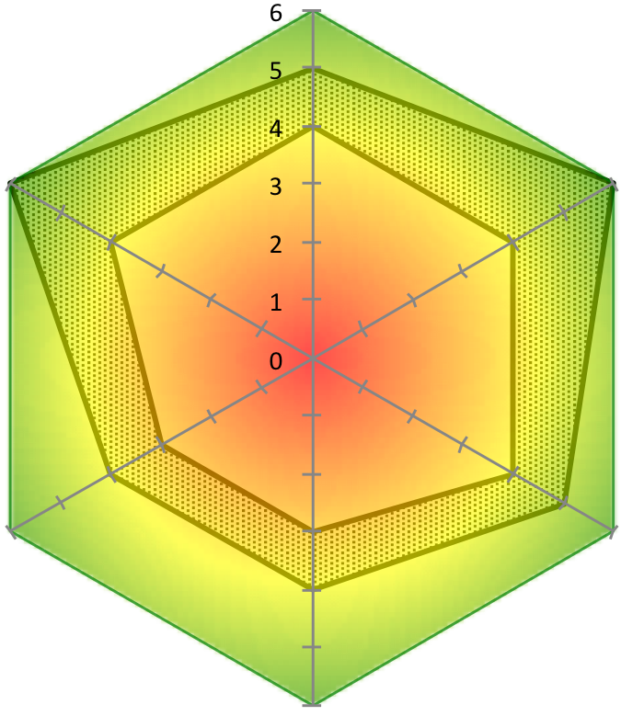
Ex Ante Critical Incident Ex Post
A Z
Macro-
Level
Micro- AGIRI Trend
Level Hazards Factors
(a, b, c) (x, y, z)
Figure 8.4

Slide 37
Driving forces | Strength | Agency control | Total Force
Dropping prices of food products | 2 | 2 | 4
Better agricultural techniques and processing | 2 | 4 | 6
Improved operational planning | 4 | 5 | 9
Increasing public support | 2 | 2 | 4
Food Production and Sustainable Agriculture
Total Force | Agency control | Strength | Restraining forces
4 | 2 | 2 | Decreasing agency budget
6 | 1 | 5 | Irregular annual precipitation
8 | 4 | 4 | Poor procedures for hiring and paying field workers
8 | 3 | 5 | Losses to fires and grazing
Figure 9.1

Slide 38
Figure 9.2

Slide 39
Government Prevails
Baseline Scenario
No drought, no flood expected
Crops and food not endangered
Government has time to establish itself and support the humanitarian project
Project endangered due to security reasons (low)
Hungry Sunburn
Government inadequately prepared for drought
No crops, no food
Food crisis will escalate conflictual tensions
Project endangered due to security reasons (medium)
Rain and Hope
Flood prevention and early warning in place
Logistics will be interrupted
Other project parameters can adapt to floods
Wildcard: Assassination of the President → Down the drain
Continuous drought
Diluvian rainfall
Hungry Rebels
Power vacuum leads to escalation of conflicts
No crops, no food
Food crisis will escalate conflictual tensions
Project endangered due to security reasons (high)
Down the drain
Flood prevention and early warning collapses
Logistics will be interrupted
Other project parameters cannot adapt to floods do to lack of funding and government support
Government Collapses
Figure 9.3

Slide 40
Figure 9.4

Slide 41
Initiation by Crisis, Priority, Mandate, Principles
Processing & Analysis of Context and Stakeholders
Trend Assessment & Planning
Implementation & Monitoring
Collection & Evaluation
Chapters 1+2
Chapter 3
Chapters 4+5
Chapters 6+7
Chapters 8+9
Evaluation & Learning
Figure C.1

